Slide 1
Academy Lab Projects – Showcase
Ali Ahmed Mohamed
AWS Web Application Project
18/10/2024

Slide 2
Contenent table
Business scenario overview
solution overview
Architecture diagram of the solution
services used
cost analysis
Demo
Final view
lessons learned

Slide 3
Business scenario overview
Problem Statement :
The current web application slows down or becomes unavailable during peak admissions due to high traffic.
Solution requirements:
Performance: Ensure fast and reliable access during peak times.
Availability: Minimize downtime with high availability.
Scalability: Handle thousands of users via auto-scaling.
Security: Protect sensitive student data with strict security measures.
Cost Efficiency: Optimize costs with AWS pricing models
Load balanced : The solution can properly balance user traffic to avoid overloaded or underutilized resources.

Slide 4
Solution overview
We deploy an Application Load Balancer (ALB) to route traffic efficiently and ensure high availability.
We set up an Auto Scaling Group to automatically adjust the number of instances based on traffic, ensuring optimal performance.
For the database, we use Amazon RDS for a managed, scalable, and secure solution with automated updates.
For development, we utilize AWS Cloud9, providing an integrated environment for easy coding and collaboration.
To ensure instances in the private subnets (Auto Scaling Group) have internet access, we deploy a NAT Gateway.

Slide 5
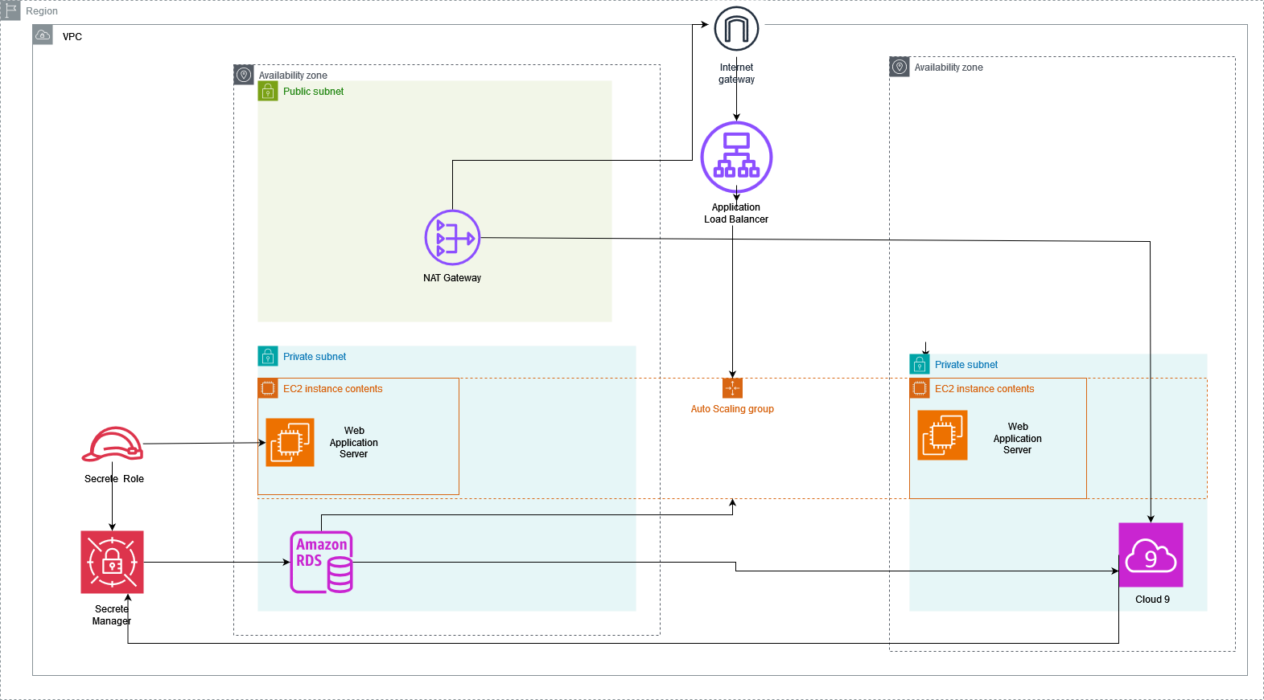
Architecture diagram of the solution

Slide 6



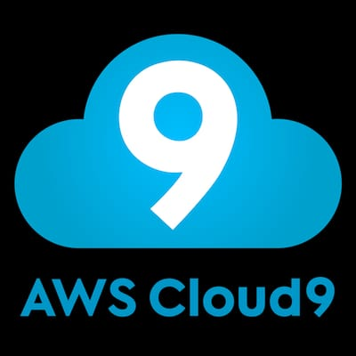


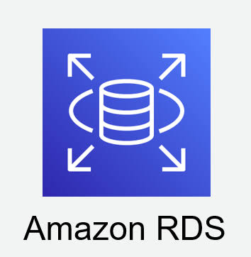
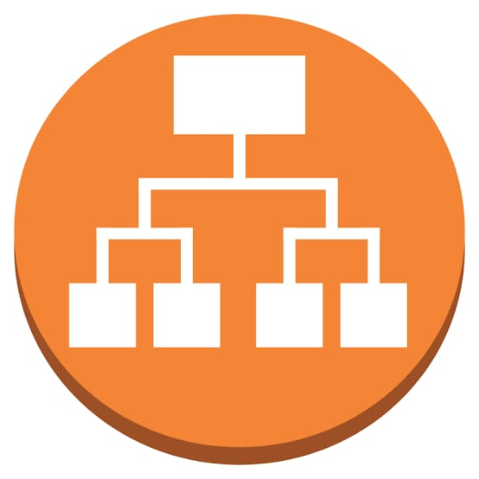
Services used
EC2: Provides scalable virtual servers in the cloud for running applications.
NAT Gateway: Enables instances in private subnets to access the internet securely without exposing them.
Internet Gateway: Allows communication between resources in your VPC and the internet.
Cloud9: A cloud-based integrated development environment (IDE) for writing, running, and debugging code.
Secrets Manager: Securely stores and manages sensitive information like database credentials and API keys.
IAM Role: Grants temporary access permissions to AWS resources for services and users without using long-term credentials.
RDS: Managed relational database service that simplifies database setup, operation, and scaling.
Application Load Balancer: Distributes incoming application traffic across multiple targets to improve fault tolerance and scalability.

Slide 7
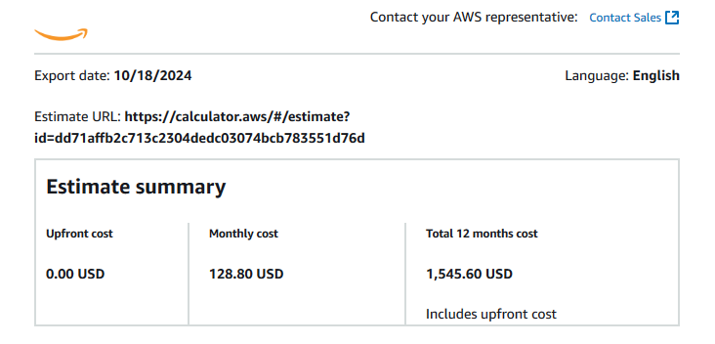
Cost Analysis

Slide 8
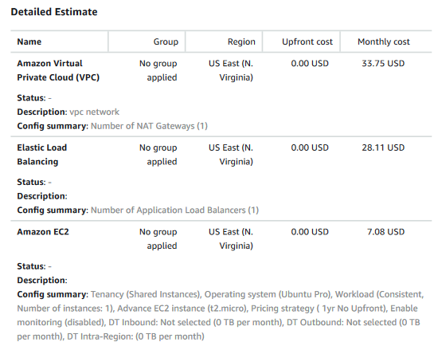
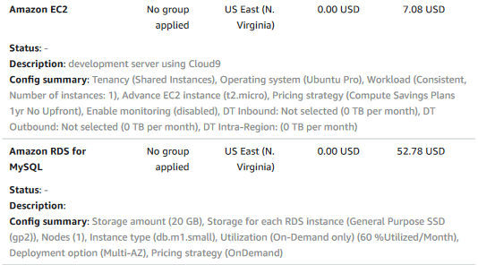
Cost Analysis

Slide 9
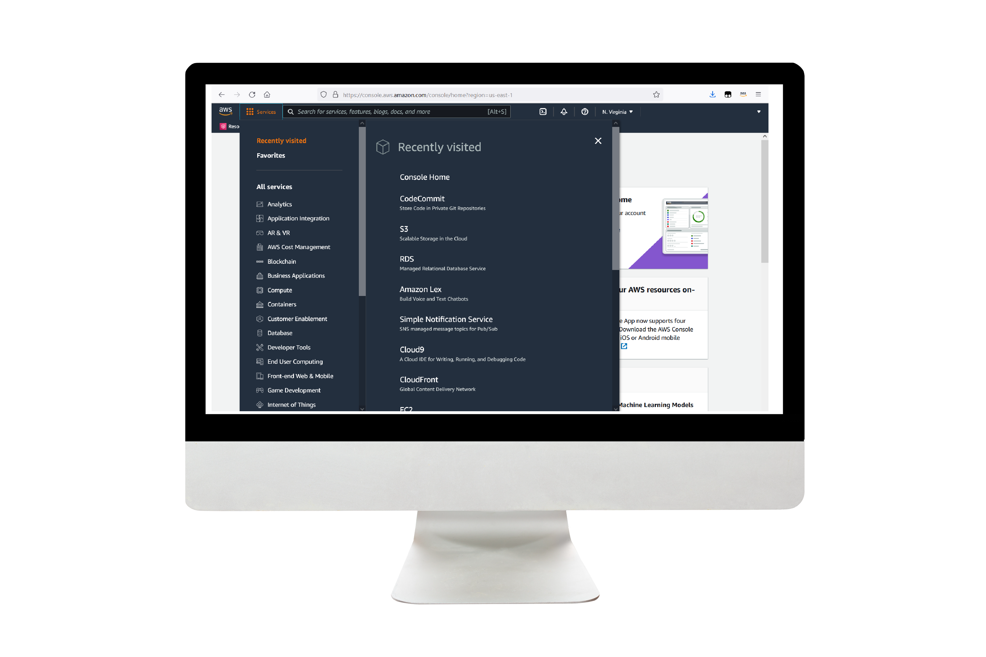
Demo
The Link of Diagram
The Link of Calculation

Slide 10
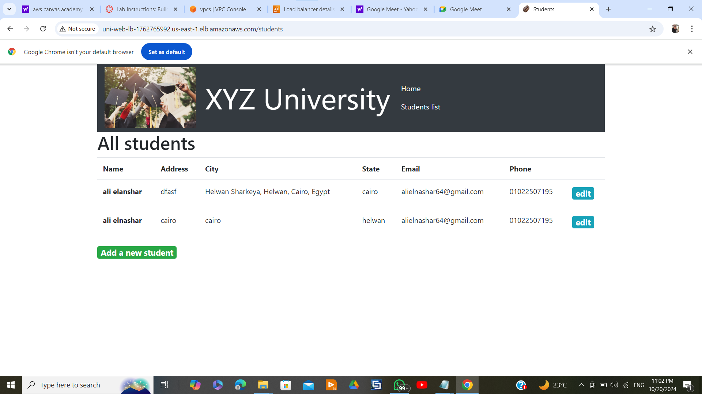
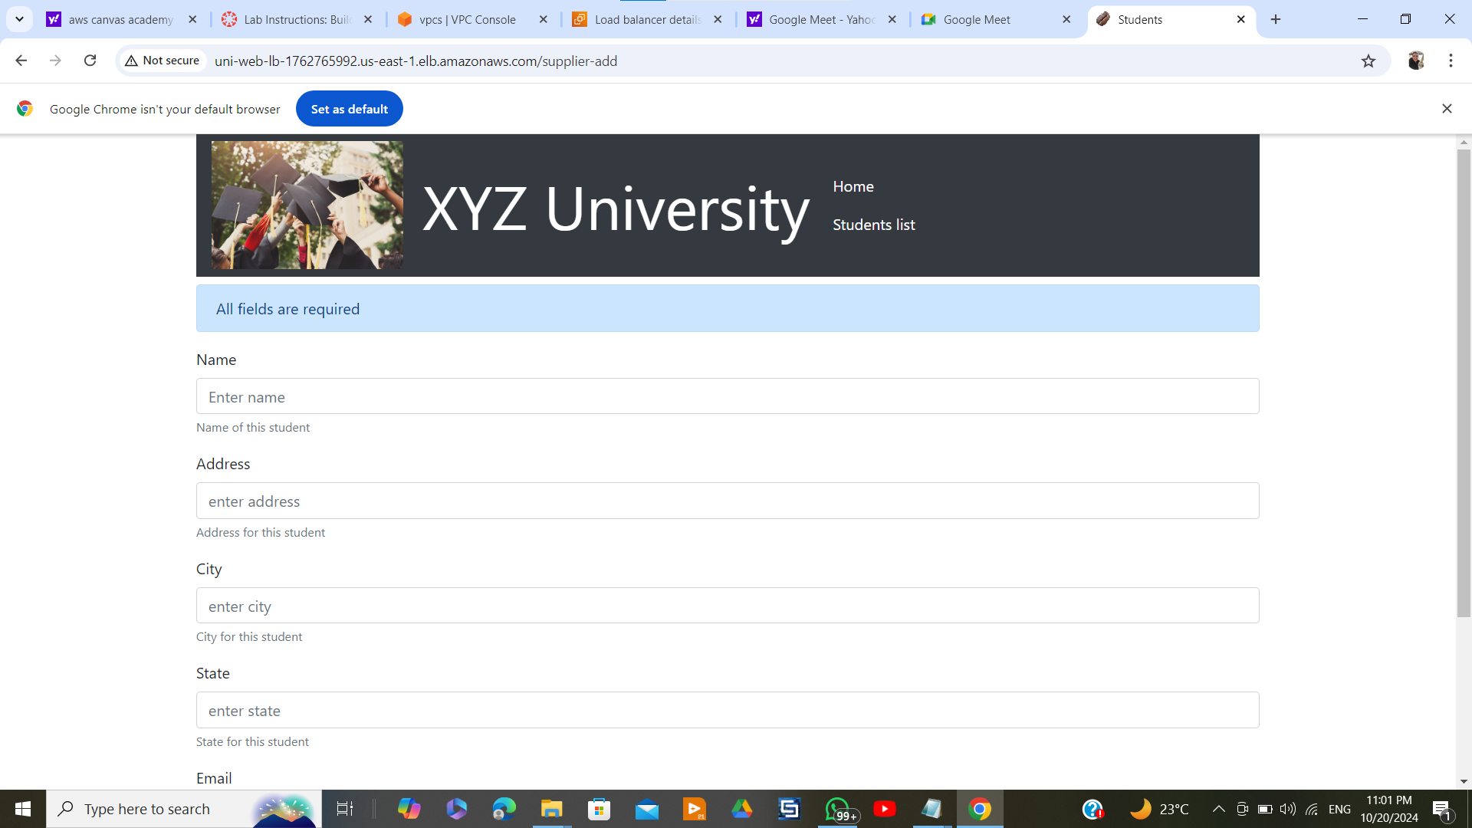
Final view

Slide 11
Lessons learned
Handling High Traffic: Implemented auto scaling to manage unpredictable traffic surges during peak admissions.
Database Management: Migrated to RDS for seamless scaling and automated updates without downtime.
Security Setup: Configured IAM roles, NAT Gateway, and VPC to ensure secure internet access and resource isolation.

Slide 12
Thank you

